Slide 1
BASIC PROFESSIONAL TRAINING COURSE
Module XXI Case Study 1
Name of Lecturer
Organization
Email address

Slide 2
BASIC PROFESSIONAL TRAINING COURSE
Leadership and Management for Safety
Leadership and Management- Inbox
Exercise.1
This material was prepared by the IAEA and co-funded by the European Union.

Slide 3
Learning objectives
The objective of this exercise is to increase the participants’ understanding of the concept of leadership and management for safety and its practical application in day-to-day situations in an organization.
Leadership and Management for Safety
07-18 May - 18-29 June 2018
3

Slide 4
2. Key points to be addressed
Participants should be able to distinguish activities that relate to leadership from those that relate to management and the impact it has on follow-up action.
Leadership and Management for Safety
07-18 May - 18-29 June 2018
4

Slide 5
3. Input for the exercise
Liliput case study LNSA
GSR Part 2 Leadership and Management for Safety
Leadership and Management for Safety
07-18 May - 18-29 June 2018
5

Slide 6
4. Tasks to be completed in the exercise
The following three (3) tasks should be completed in 90 minutes.
Task 1
You are part of the management of LNSA (regulatory body) and you have just walked into the office and found the following tasks in your inbox. What do you do with this list?
Leadership and Management for Safety
07-18 May - 18-29 June 2018
6

Slide 7
4. Tasks to be completed in the exercise
Task 1. List of items.
The minister has called an impromptu meeting on the schedule on the for the new power plant - the utility wants to accelerate the plan for building the new NPP and it is expected that the minister will support this plan and ask the regulatory body to be in a position to deal with the accelerated plan.
Meeting with foreign delegation from a country that wants to build partnership with the LNSA
Expert meeting to review draft of new regulations on radiation protection
There is note left indicating that your assistant has called in sick
Presentation at university conference on the role of the LNSA
There is a memo from the HR department requesting that a workforce plan for the regulatory body be developed by the end of next month.
Leadership and Management for Safety
07-18 May - 18-29 June 2018
7

Slide 8
4. Tasks to be completed in the exercise
Task 1. List of items (continued).
An internal memo from the Administration Department is requesting a revision to budget projections in light of current demands and the ramp up in interactions with the utility
The Review and Assessment Department has developed drafts of safety assessment standards that need to be reviewed and approved
There is a letter from a supplier requesting clarification on the scope of future LNSA inspections with respect to suppliers
There is a lunch on the agenda with a representative of an anti-nuclear NGO
There is a memo from the Communications Department regarding a request for an interview by a journalist from the local newspaper
Leadership and Management for Safety
07-18 May - 18-29 June 2018
8

Slide 9
4. Tasks to be completed in the exercise
Task 1. List of items (continued).
The Public and International Affairs Department has submitted a draft of the first major activity report that needs to be produced this year by the LNSA
The Administrative Department has reported the failure of the air condition in Building B
The Licensing Department is requesting money to hire a consultant to help them develop a licensing process (the department has identified three potential candidates)
The Inspection and Enforcement Department is requesting that a job or position description form be developed for the position of the head of the department
There is a letter from the governor of one of the proposed sites of the NPP requesting the results of the Environmental Impact Analysis (EIA) for the site
Leadership and Management for Safety
07-18 May - 18-29 June 2018
9

Slide 10
4. Tasks to be completed in the exercise
Task 1. List of items (continued).
There is note from the minister requesting a strategic plan for the next five years
The Administrative Department has sent a note warning that travel costs for meetings and conferences abroad (e.g. to the IAEA) have exceeded budgeted levels The Regulations and Guides Department is requesting the formation of an external advisory group to help it develop regulatory documents
A retirement party needs to be organized for the most senior expert in the Licensing Department
There is a memo from the Administration Department complaining about the candidate that the Licensing Department is insisting on hiring (the candidate is inexperienced but he or she is related to one of the managers in the department)
Leadership and Management for Safety
07-18 May - 18-29 June 2018
10

Slide 11
4. Tasks to be completed in the exercise
Task 2
Individually determine which items in the list are leadership tasks and which ones are management tasks?
Which of these tasks may have an impact on safety?
Which of these tasks are related to the Regulatory Body, Goals, Strategies, Objectives and Plans?
Leadership and Management for Safety
07-18 May - 18-29 June 2018
11

Slide 12
4. Tasks to be completed in the exercise
Task 3
Discuss the results of the individual assessment of these tasks and come to a consensus as a group on which tasks are leadership tasks and which ones are management tasks. Prepare a presentation of your consensus results.
Leadership and Management for Safety
07-18 May - 18-29 June 2018
12

Slide 13
5. Points for further discussion
Care should be exercised in the analysis of the tasks, as some may be both leadership and management task depending on the situation.
Consider the reasons why some tasks are both leadership and management tasks
Leadership and Management for Safety
07-18 May - 18-29 June 2018
13

Slide 14
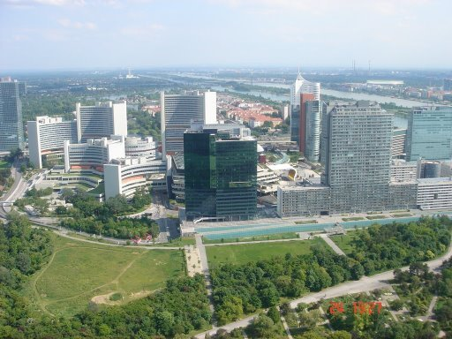
Thank you!
Notes:
Thank you!

